Slide 1




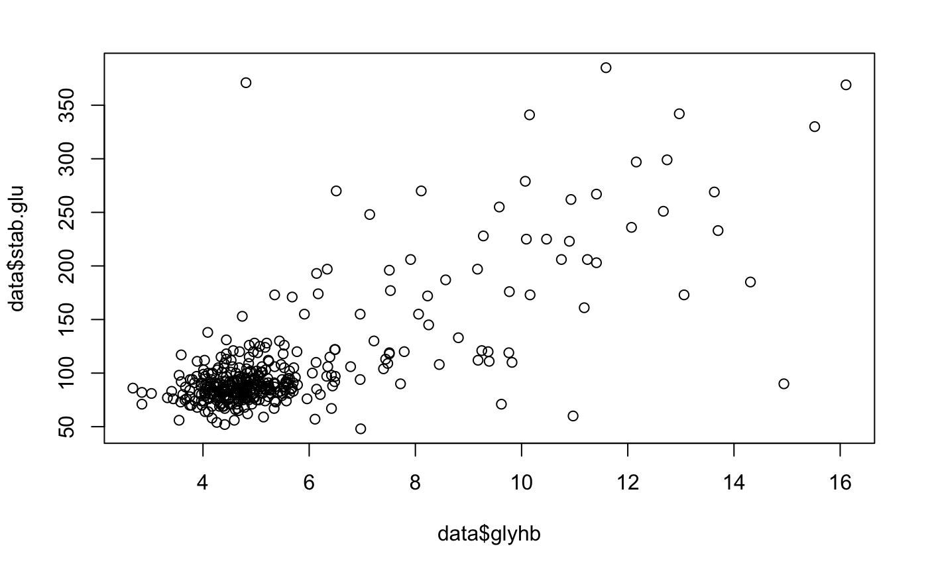
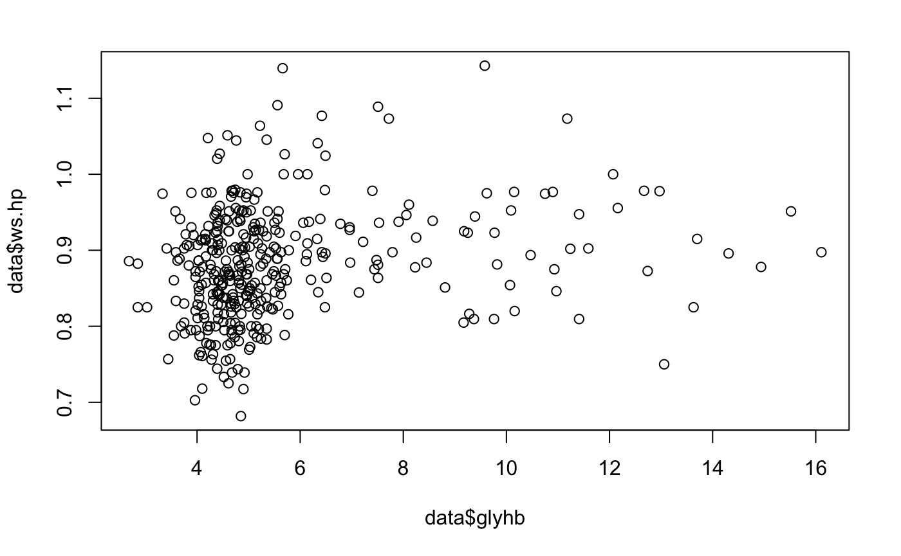
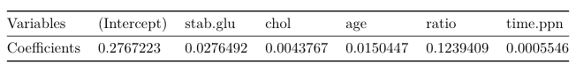

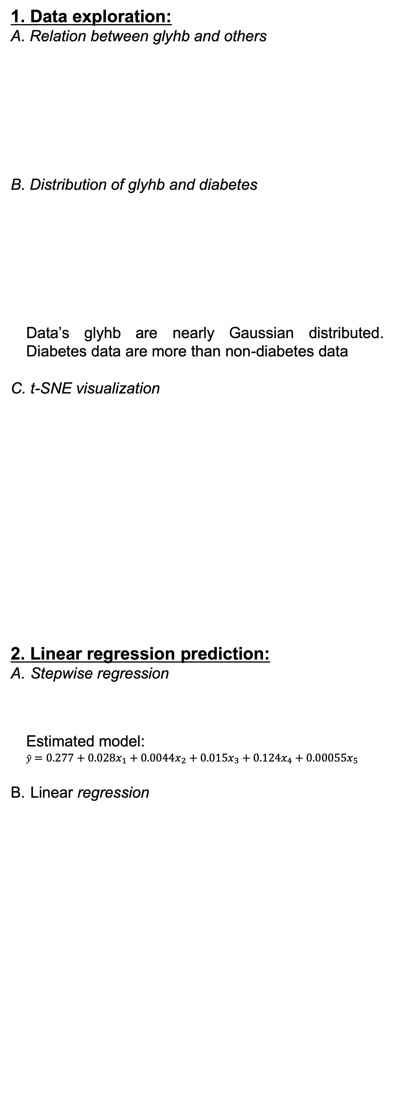
Prediction of diabetes condition by clinical test data
Ziyu Su
suz4@rpi.edu
¹Rensselaer Polytechnic Institute, Tetherless World Constellation, Troy, NY, United States,
Abstract
Data Analysis
Diabetes is a disease in which your blood glucose, or blood sugar, levels are too high. Glucose comes from the foods you eat. It prevents insulin from being made by our body. As a result, glucose cannot get into your cell to provide energy. Excessive glucose will make people easy to be tired and leads to problems like heart disease, kidney disease, foot problems, etc. According to a survey from CDC [1], 15 percent of the population in the United States have diabetes (2013-2016) and it is the 7th biggest cause of death. Thus, it is important for us to diagnose diabetes early before it becomes serious. Fortunately, physicians can use Glycosolated Hemoglobin as a criterion to diagnose diabetes. This project will explore the relation between Glycosolated Hemoglobin and other variables, and build two models to predict the diabetes based on a diabetes patients’ dataset. The models can help us to know how the physical data indicate diabetes.
In order to compare linear and nonlinear models’ performance on our dataset, linear regression and Support Vector Machine (SVM) model will be applied to figure out the problem.
Workflow for data preprocessing
Clean
Remove irrelative data
Remove data with missing attributes
Convert
Convert character attributes into numeric ones
Combine some attributes into one attribute
Label
Create label based on glyhb
Figure 5. Model with variable selection
Label Predict | 0 | 1
0 | 60 | 4
1 | 2 | 8
Table 1. Prediction without selection
Accuracy=91.89%
1. Data exploration:
A. Relation between glyhb and others
B. Distribution of glyhb and diabetes
Data’s glyhb are nearly Gaussian distributed. Diabetes data are more than non-diabetes data
C. t-SNE visualization
2. Linear regression prediction:
Stepwise regression
Estimated model:
$$\hat{y}=0.277+0.028x_{1}+0.0044x_{2}+0.015x_{3}+0.124x_{4}+0.00055x_{5}$$
Linear regression
Label Predict | 0 | 1
0 | 62 | 4
1 | 0 | 8
Table 2. Prediction with selection
Accuracy=94.59%
Data Description
Figure 1. a) stab. glu vs. glyhb; b)ws.hp vs. glyhb
3. SVM prediction:
A. SVM fitting
All of the variables were used to fit the model, since stepwise regression is used for multilinear regression.
Prediction and analysis
Our dataset is collected from data.world and is open sourced by Vanderbilt University [2]. It contains people’s physical test results and diagnosis results. I choose this dataset because it is comprehensive and reliable, which will help my model to get accurate results.
In this dataset, 403 people’s data are collected and some of them are incomplete. There are 19 columns in the dataset, include the test results like blood pressure, height, stabilized glucose, etc. and some meaningless attributes like id, name, etc. In these attributes, Glycosolated Hemoglobin (glyhb) is the key attributes to diagnose diabetes. According to the description provided by the source website, people whose glyhb is 6.5 or greater will be labelled as diabetes patient.
Figure 2. a) Histogram of glyhb; b) Histogram of label
Label Predict | 0 | 1
0 | 62 | 7
1 | 0 | 5
Table 3. Prediction using SVM. Accuracy=90.54%
4. Conclusion:
Our dataset has a complex manifold structure in 2D space. Two classes of data are twisted together. However, by using stepwise regression to select variables, we can find a kind of linear relation between glyhb, the key to diabetes diagnosis, and the selected variables. Without variable selection before fitting, model can achieve accuracy of 91.89%. After using stepwise regression to select variables, model can achieve accuracy of 94.59%, which is a significant improvement. It shows that the linear relation between glyhb and the predictors became stronger by removing some less important variables.
SVM is usually good at creating nonlinear boundary for classification. Thus, it also accurately predict diabetes data, in 90.54% accuracy. Obviously, linear regression works better than SVM in this data. Although it is only 1% higher than SVM’s result, it is a big difference and significant for patients.
From the coefficients of the linear model, I surprisingly find that cholesterol/HDL Ratio is even more important than stabilized glucose for regress glyhb. Therefore, except for glucose, we should also pay attention to our cholesterol for a healthy body condition.
Experiment setting
Cleaning and preprocessing the dataset
Visualizing the dataset in 2 dimensional space using t-SNE
Predicting diabetes using linear regression
Selecting variables using stepwise regression
Training regression model with training data
Fitting glyhb value on test data and determining diabetes based on 6.5 threshold
Predicting diabetes using SVM
Training SVM model with training data
Predicting diabetes on test data
For both of the models, 80% of the data will be used as training data and 20% will be used as test data.
Figure 3. t-SNE visualization of dataset
Sponsors:
Figure 4. Model without variable selection
Glossary:
Python – A programming language, capable of processing data/statistical analysis
R – A program to process data and perform statistical analysis
Package (P) or Library (R): software package to be loaded to perform extra tasks
Pandas – An useful data manipulation package in python
Df, dataframe – Data manipulation structure in R & python pandas
Levels in R dataframe – for factor data, the possible number of choices are levels
Resources:
[1] Diabetes statistics: https://www.cdc.gov/nchs/fastats/diabetes.htm
[2] Vanderbilt diabetes dataset: http://biostat.mc.vanderbilt.edu/wiki/Main/DataSets

